Slide 1
To replace with my own drawing

Slide 2
CSS143 Computer Programming (II)

Slide 3
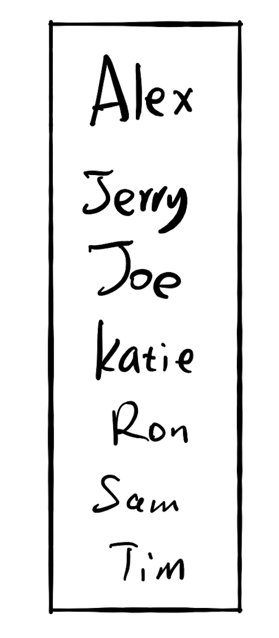
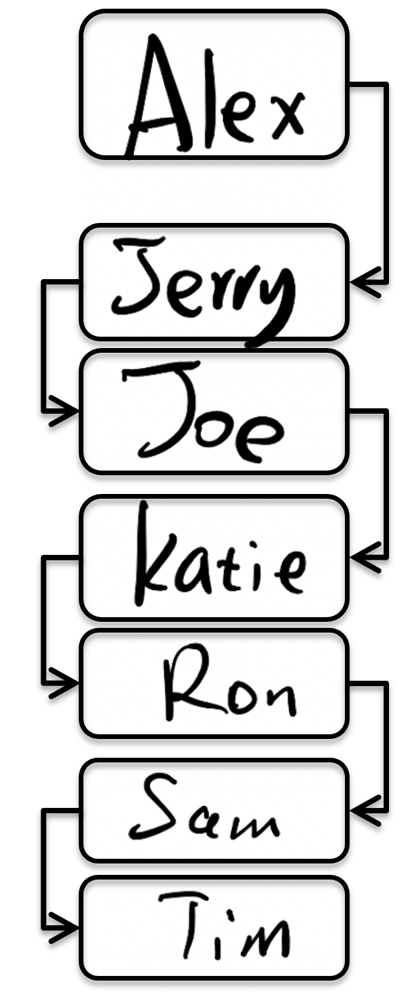
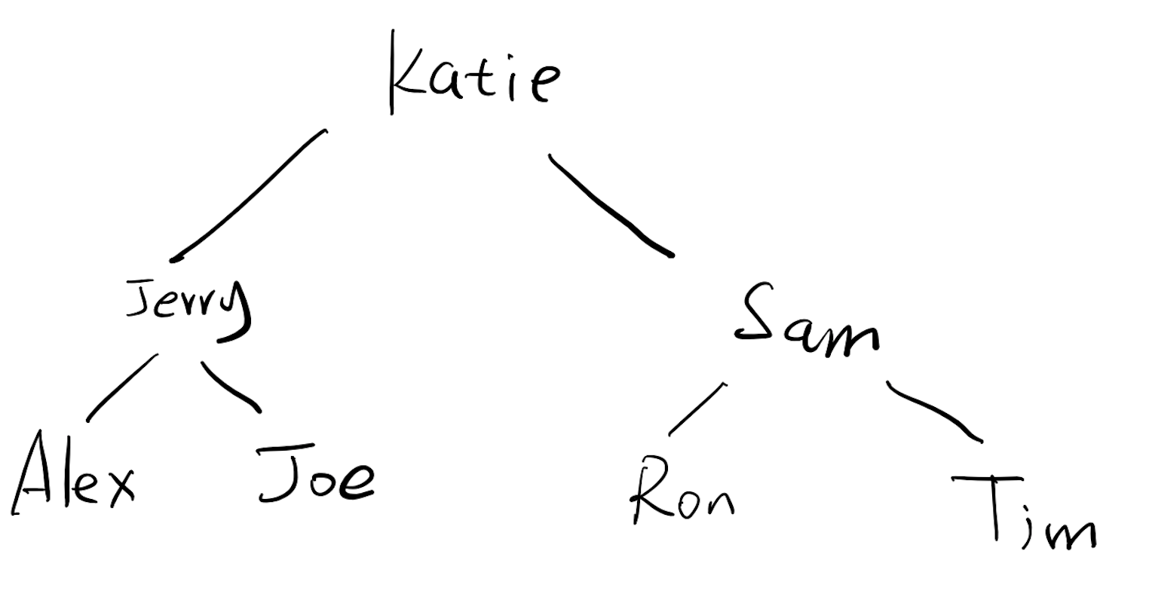
If there are 10,000 users
Each comparison takes 1 seconds
13s
Can we better?
13s
2.78m

Slide 4

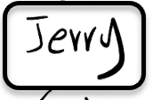
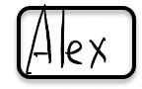

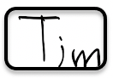


Hash Algorithm

Slide 5

0
3
hashing
6
7
9
12
13
hashing
8

Slide 6
Key value pair: (K, V)
(K,V)
Hash function
6
Hash key
key K

Slide 7
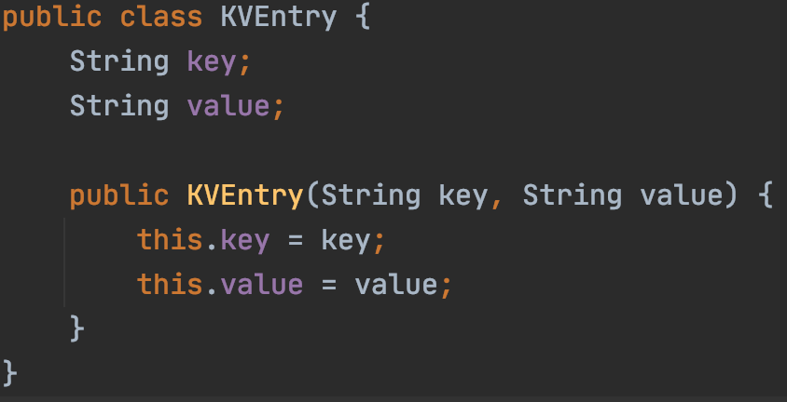
Dictionary ADT

Slide 8
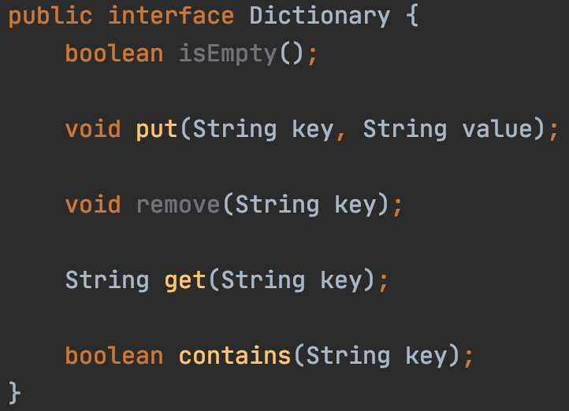
Dictionary ADT
Interface

Slide 9
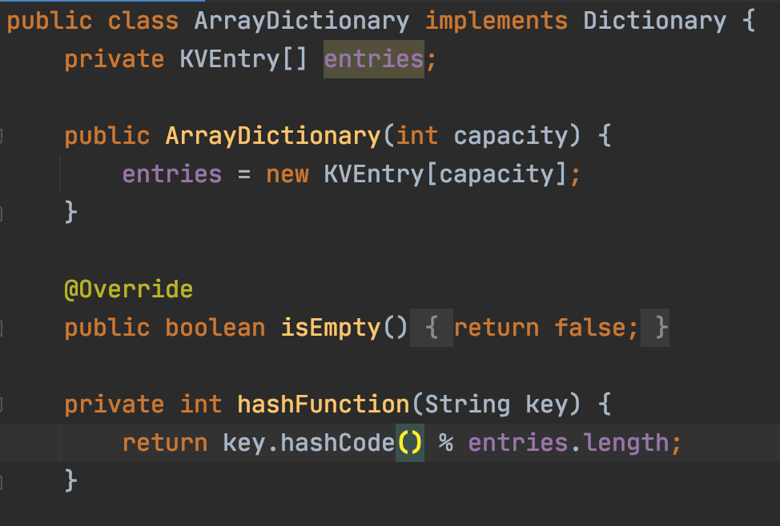
Dictionary ADT
Implementation

Slide 10
Hashing
Key x
Index y
“Key”
“Hash Key”
String
Integer

Slide 11
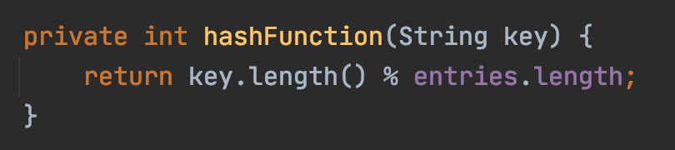
Hashing
Key x
Index y
String
Integer

Slide 12
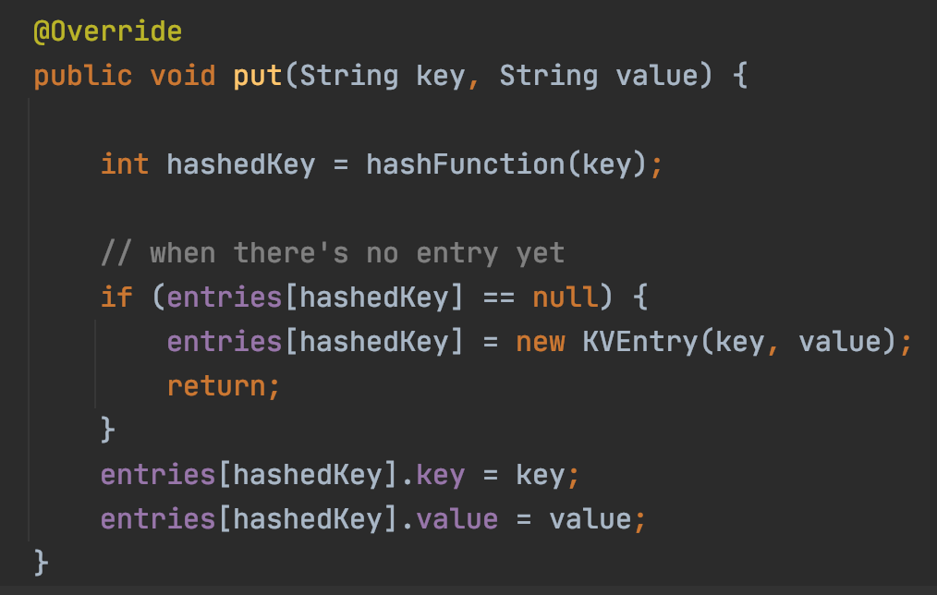
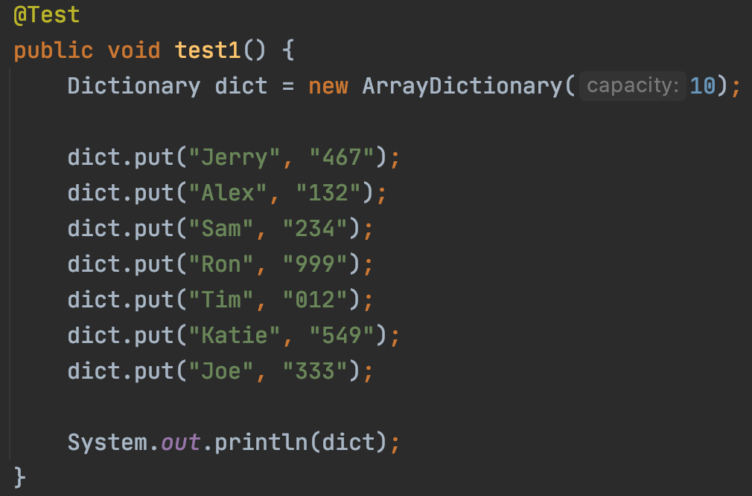
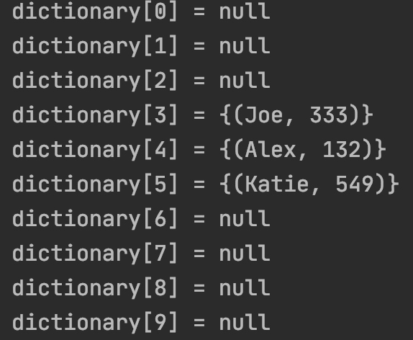
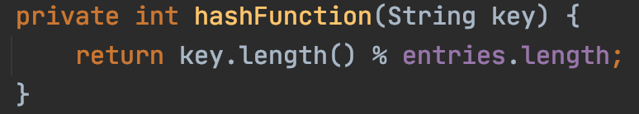
Hash keys clustered

Slide 13
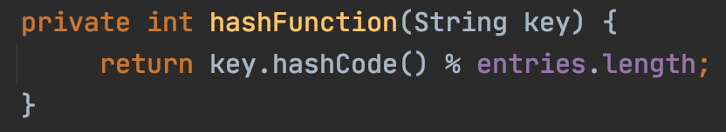
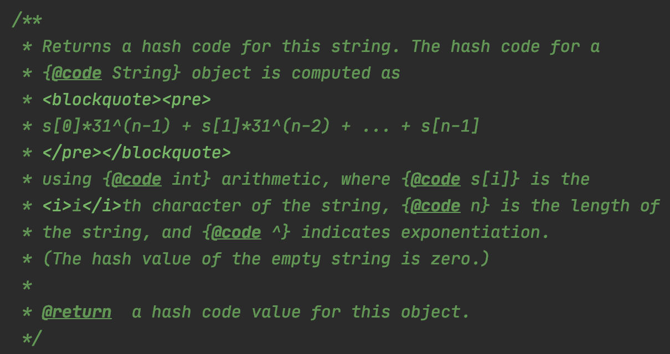
Hashing
Key x
Index y
String
Integer

Slide 14
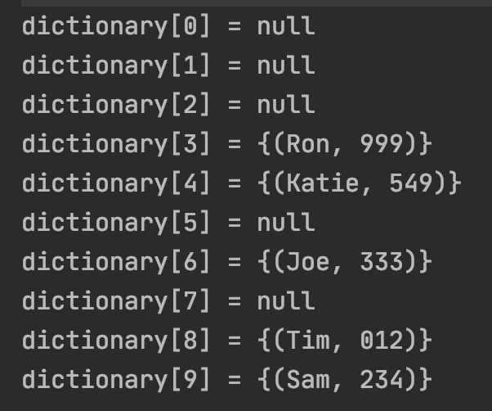
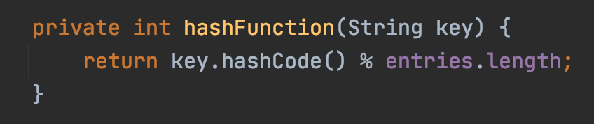
Better, but hash keys still clustered

Slide 15
Collision
collision
key=Sam
key=Ron

Slide 16
Collision
Three approaches
Better hashing algorithm
Find another location in the table
3. Modify the entry to be able to hold more than one set of values
https://medium.com/basecs/hashing-out-hash-functions-ea5dd8beb4dd
“open addressing”

Slide 17
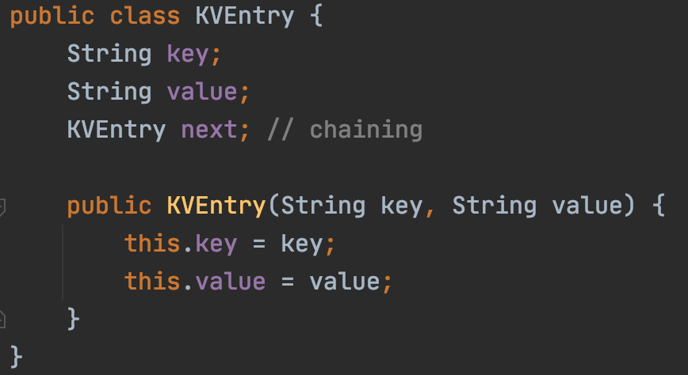
Collision
Sam
Ron
key=Sam
key=Ron

Slide 18
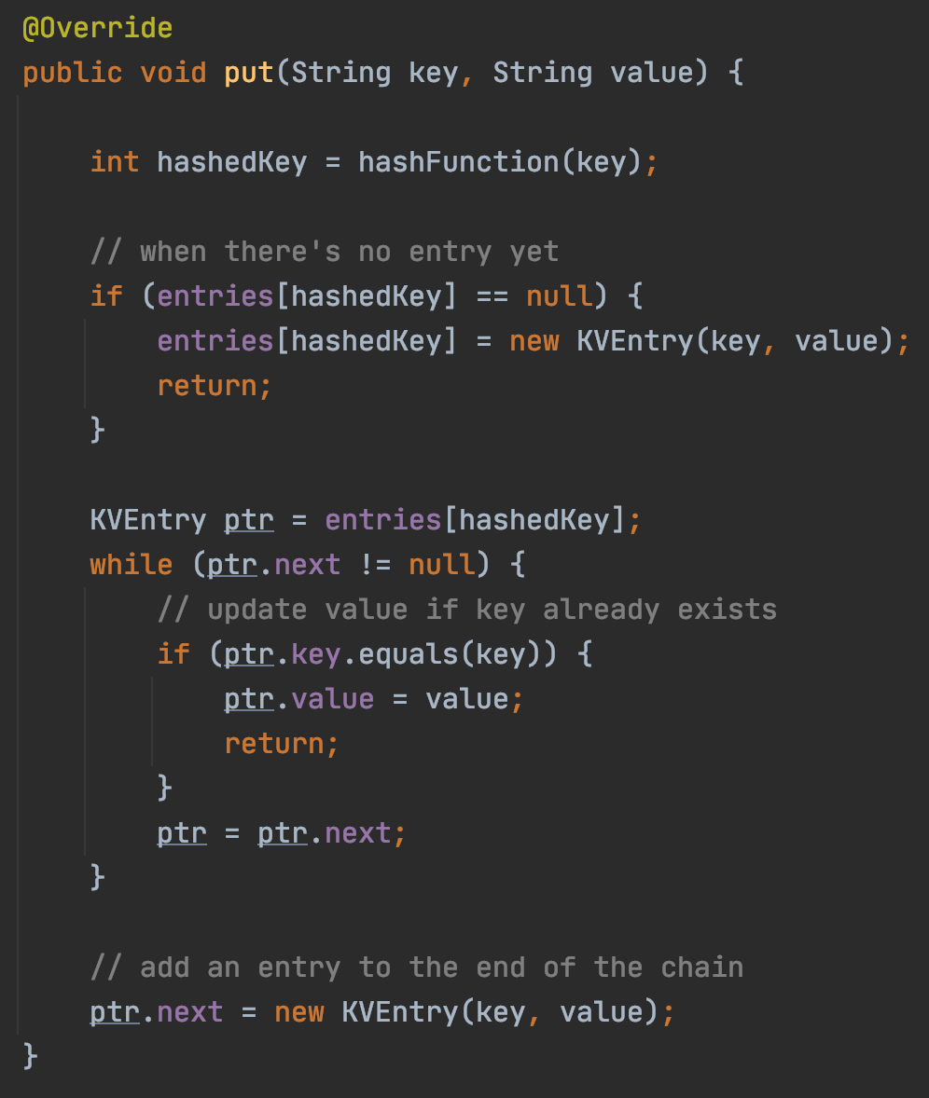
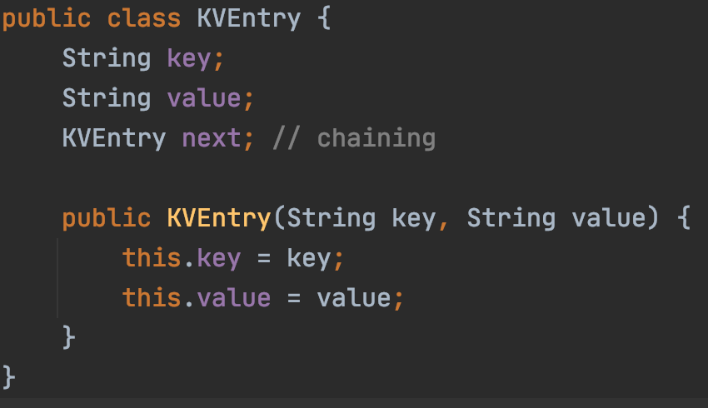
Chaining for collision

Slide 19
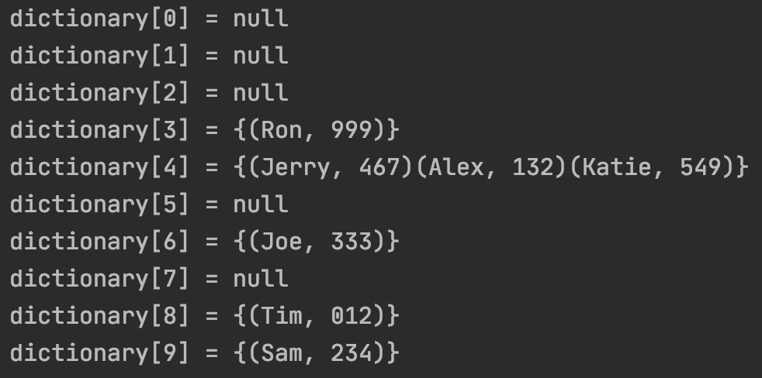
Chaining

Slide 20
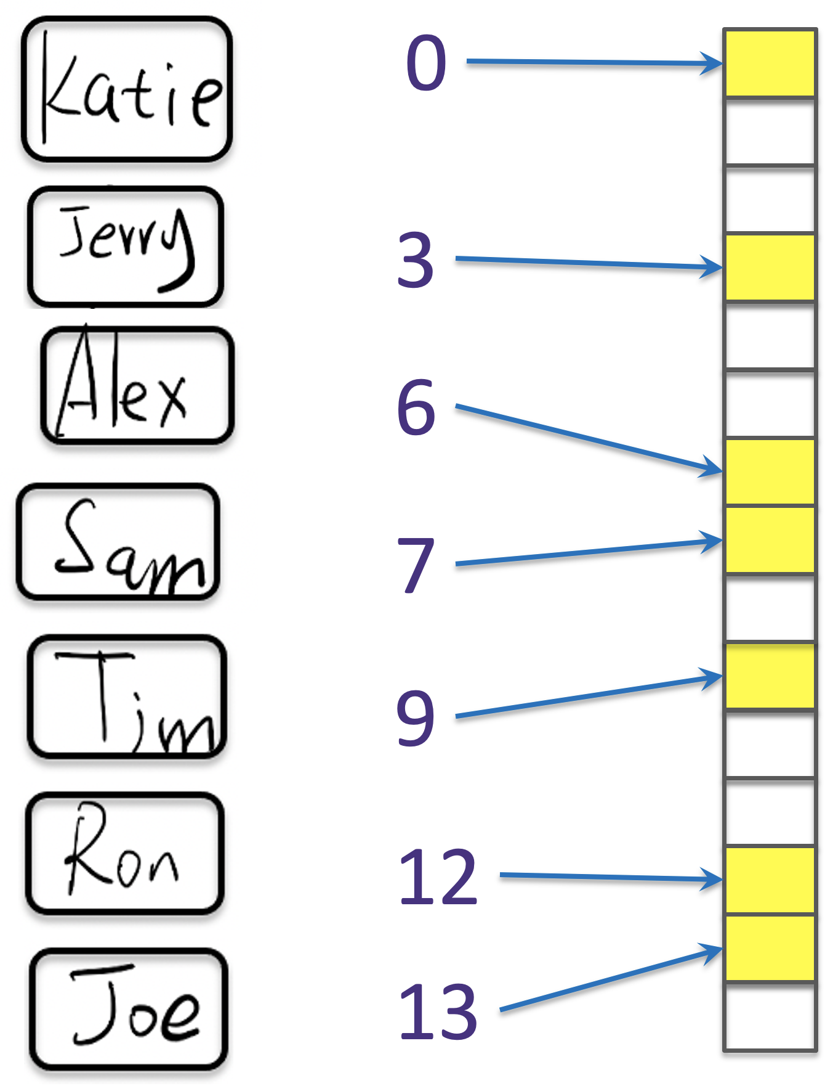
If there are 10,000 users
13s
Each comparison takes 1 seconds
13s
2.78m
~1s

Slide 21
If there are 10,000 users
Each comparison takes 1 seconds
Sam
Ron
Alex
Jerry
Katie
Joe
Tim
2.78m ☹
~1s

Slide 22
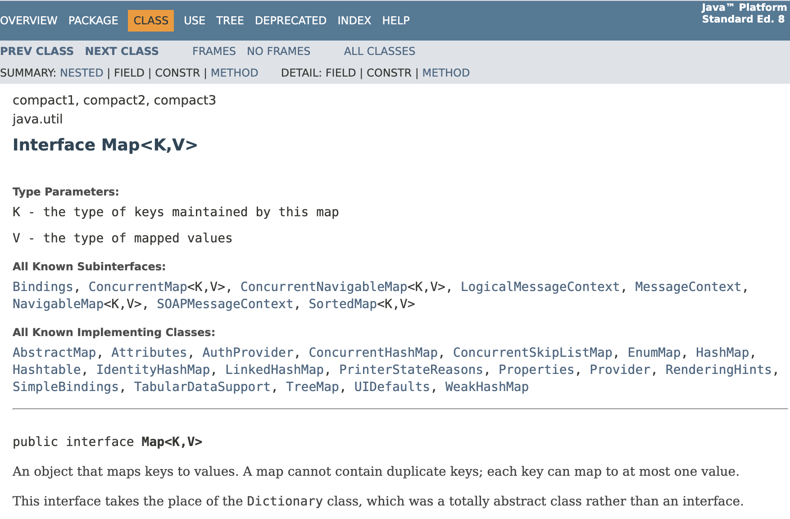
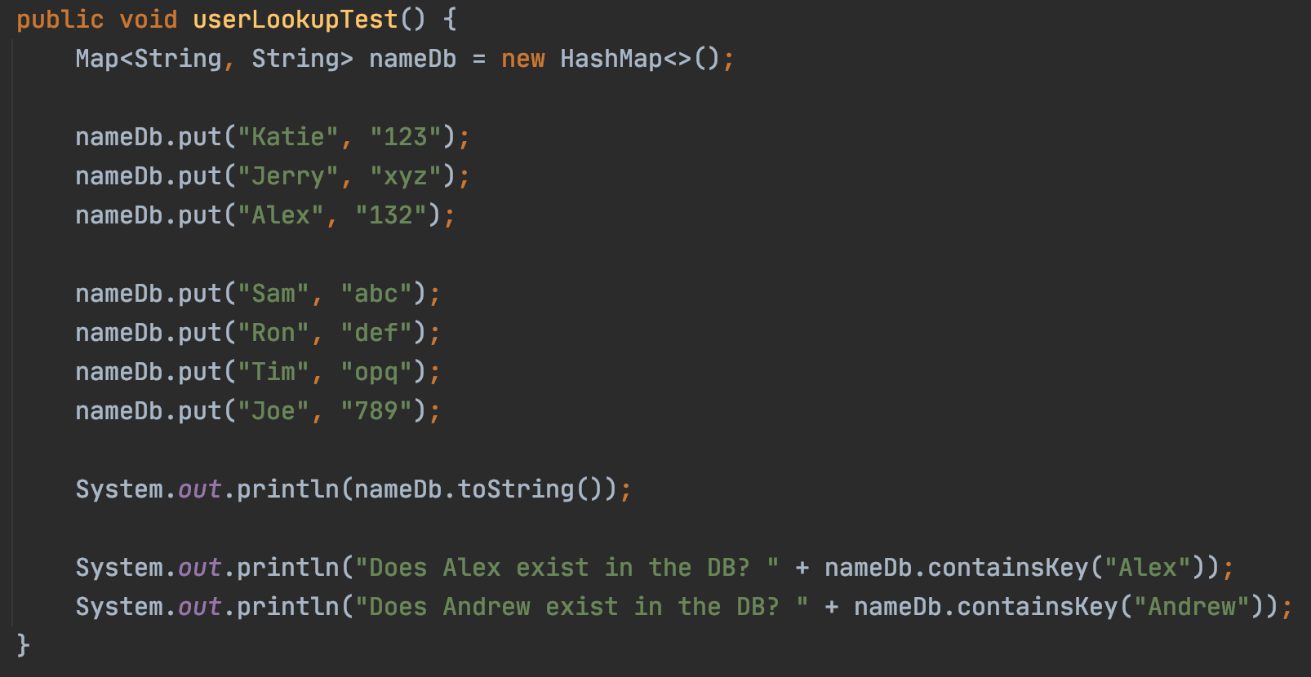
Java Implementation

Slide 23
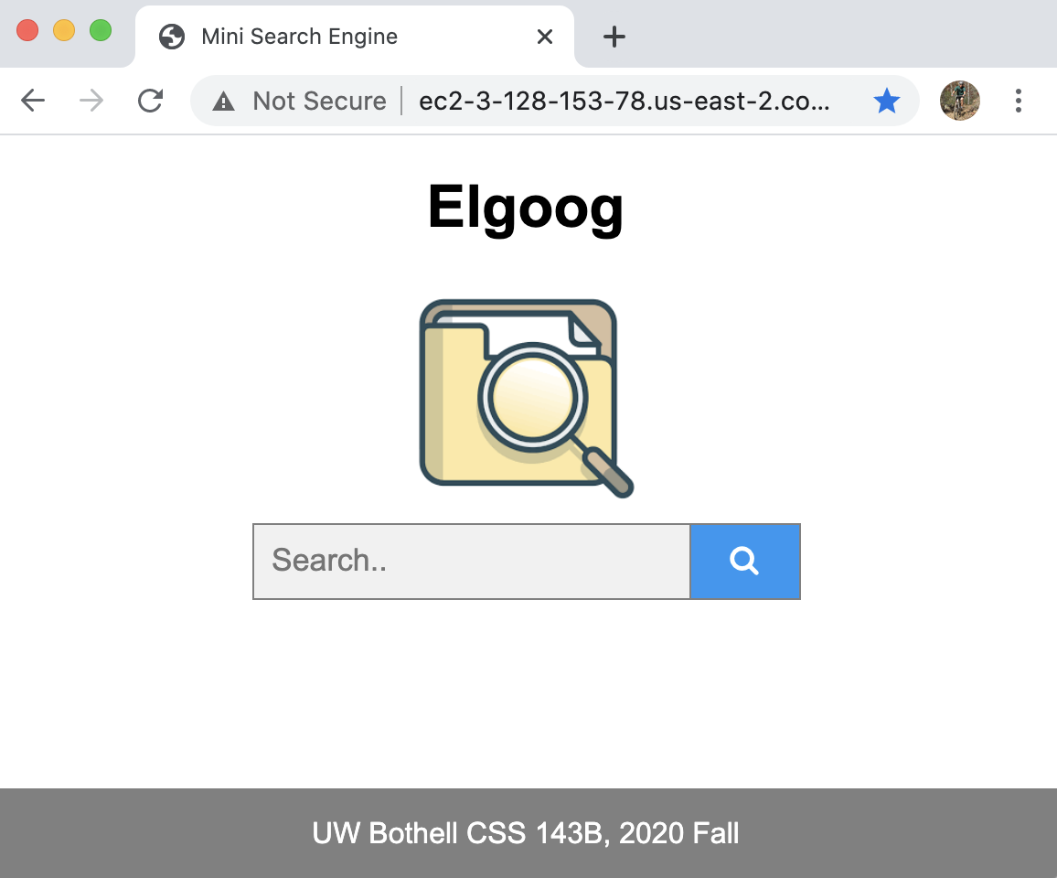
Final Project Review

Slide 24
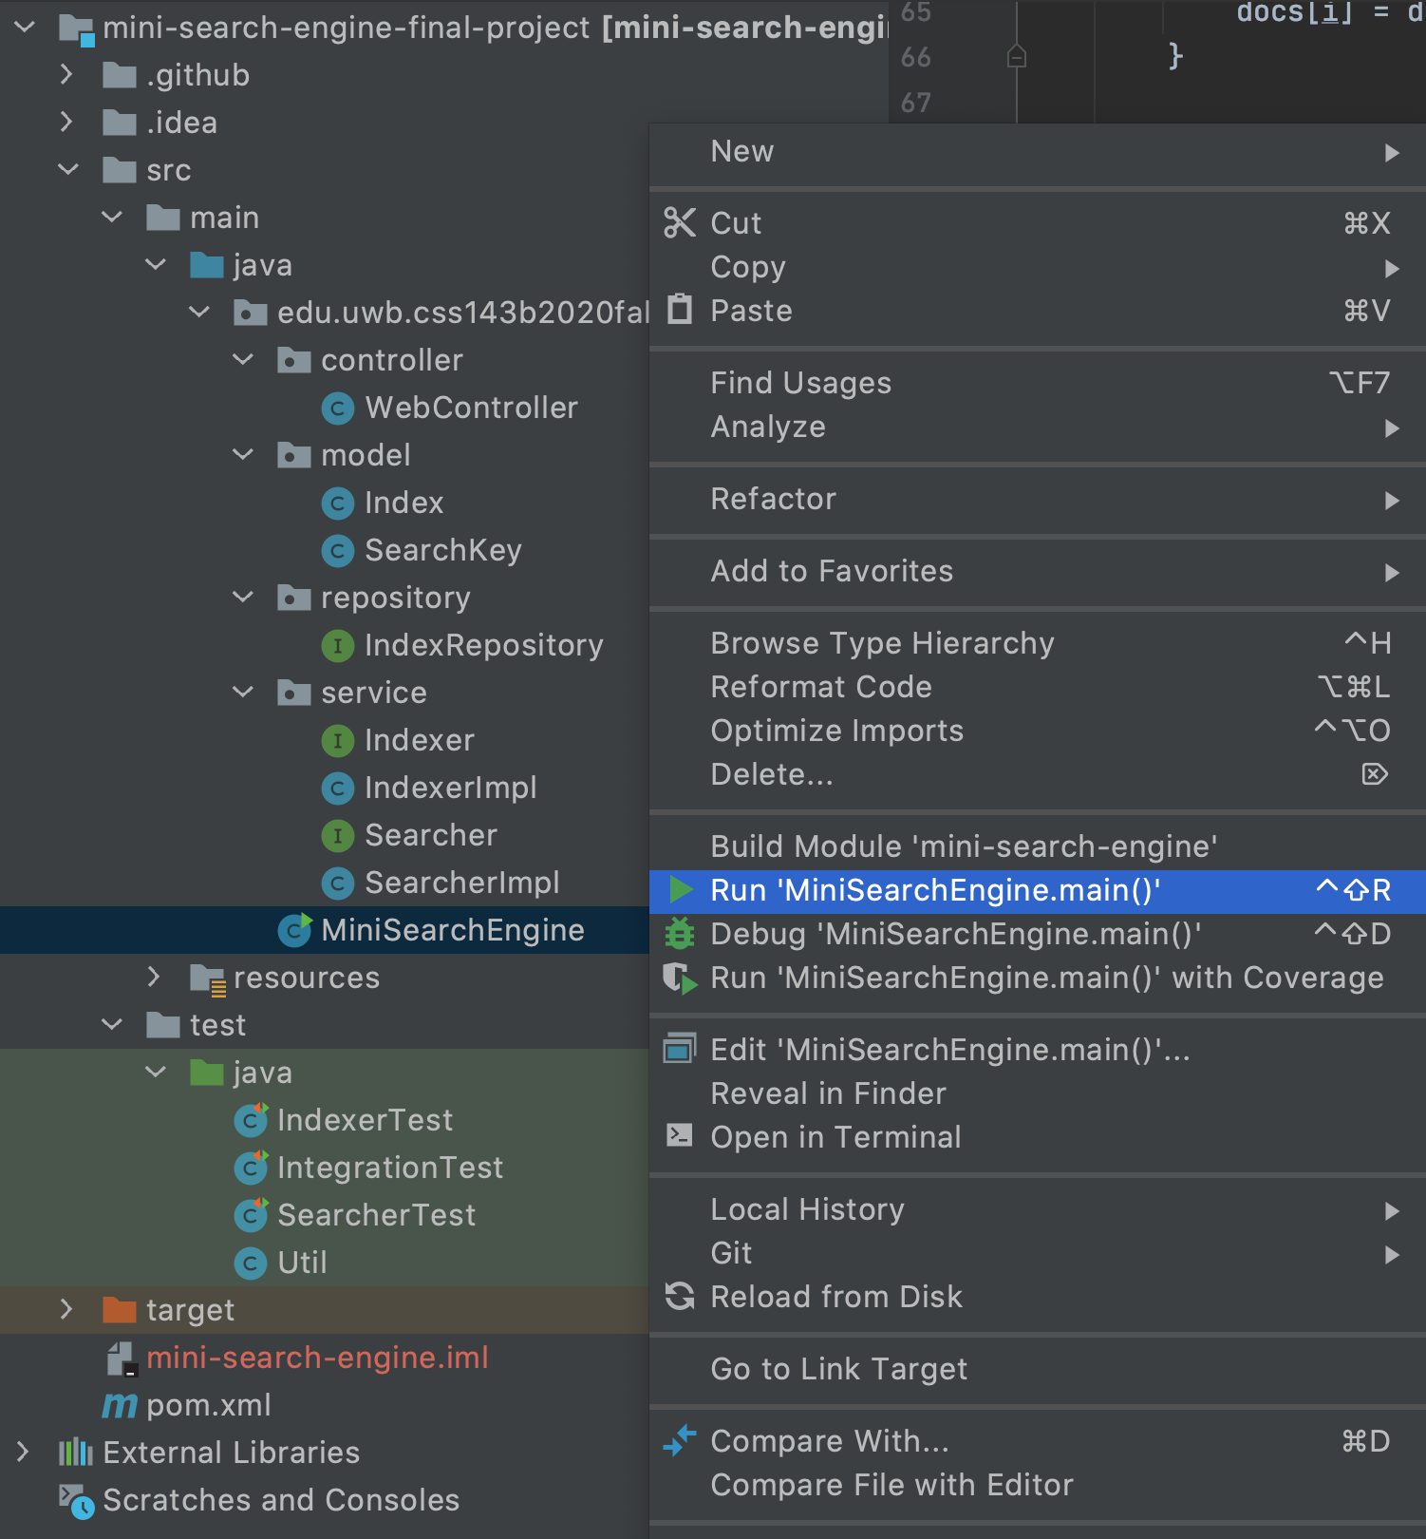
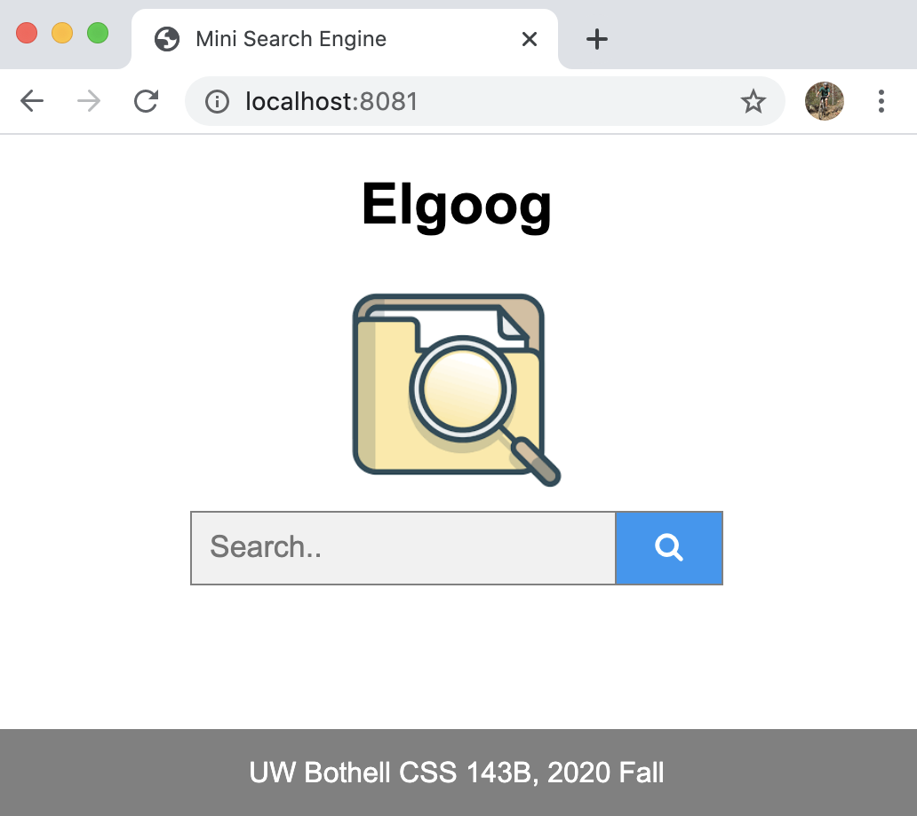
Final Project Review

Slide 25
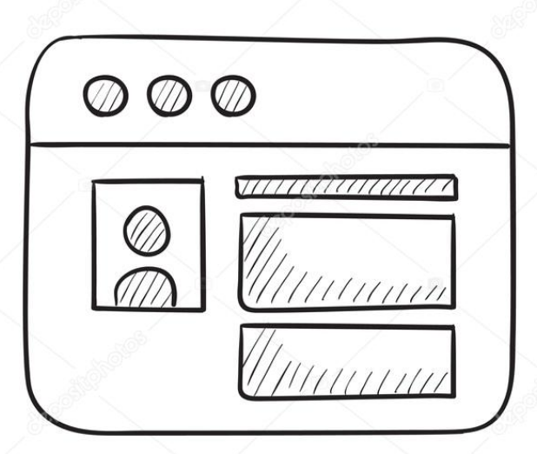
Final Project Review
Demo Site:
http://ec2-3-128-153-78.us-east-2.compute.amazonaws.com:8081
"/", "/search", "/home"
Controller
Repository
Database
Service
Webpage

Slide 26
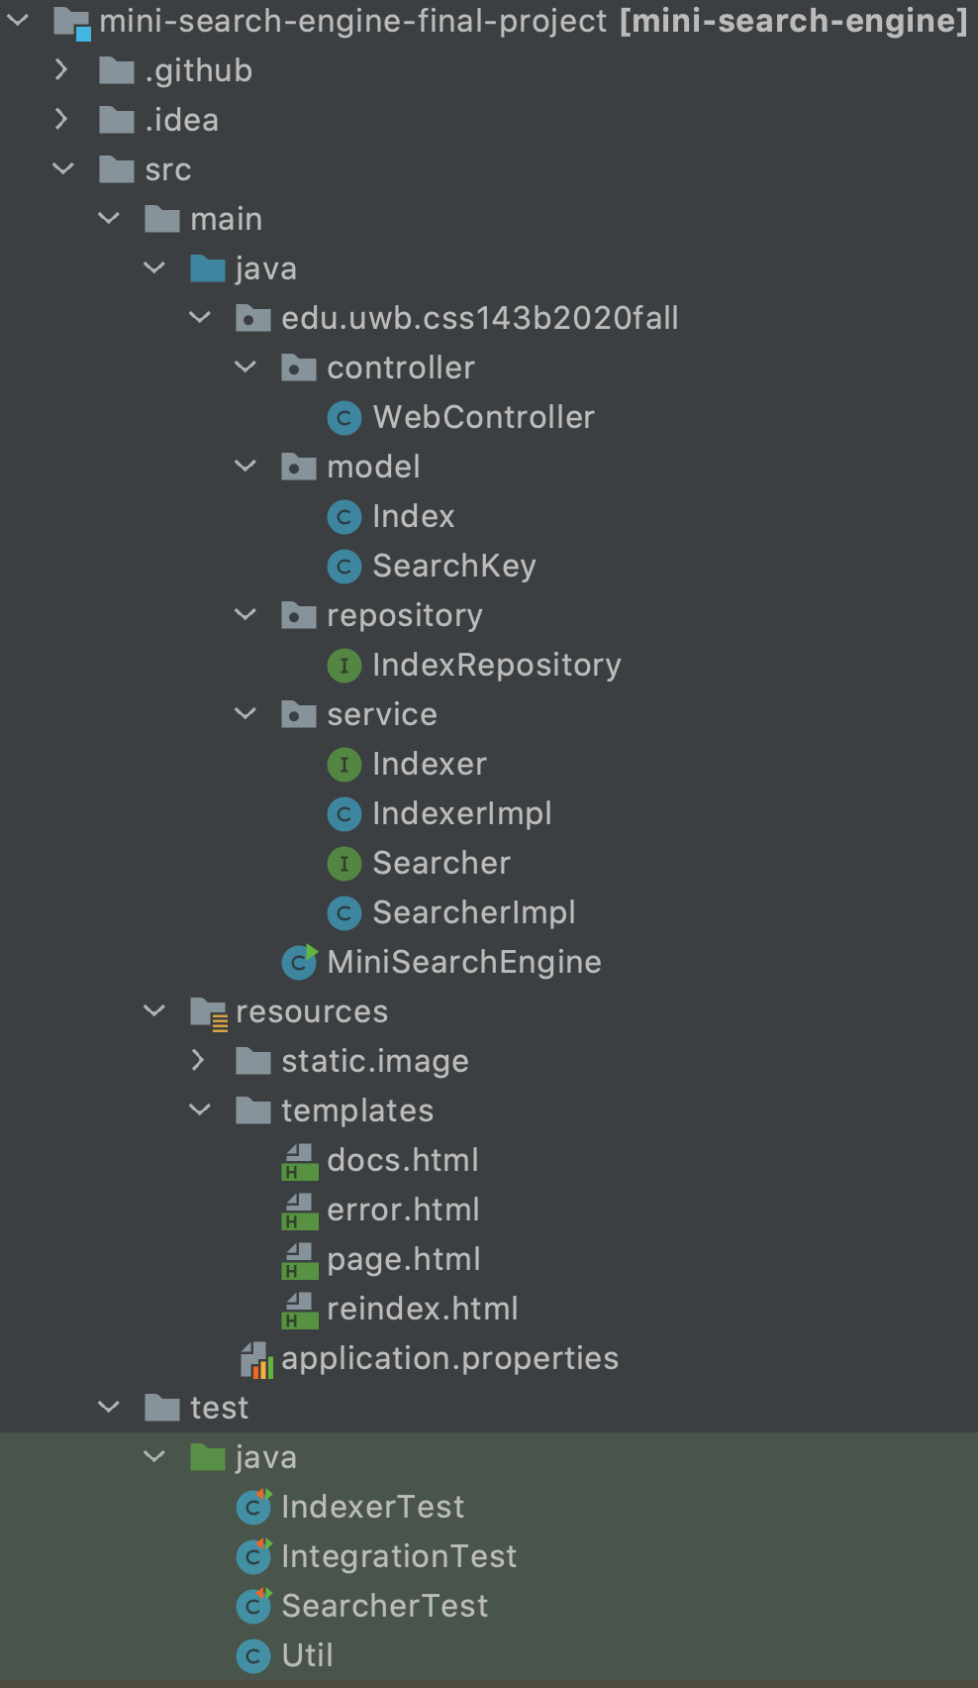
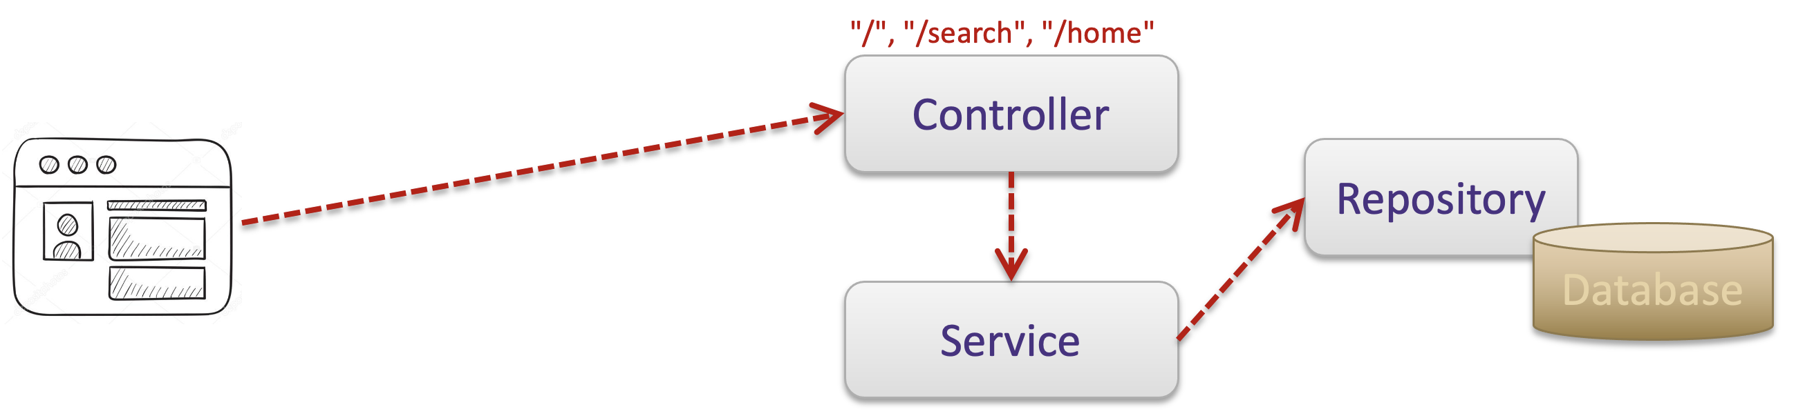
Final Project Review

Slide 27
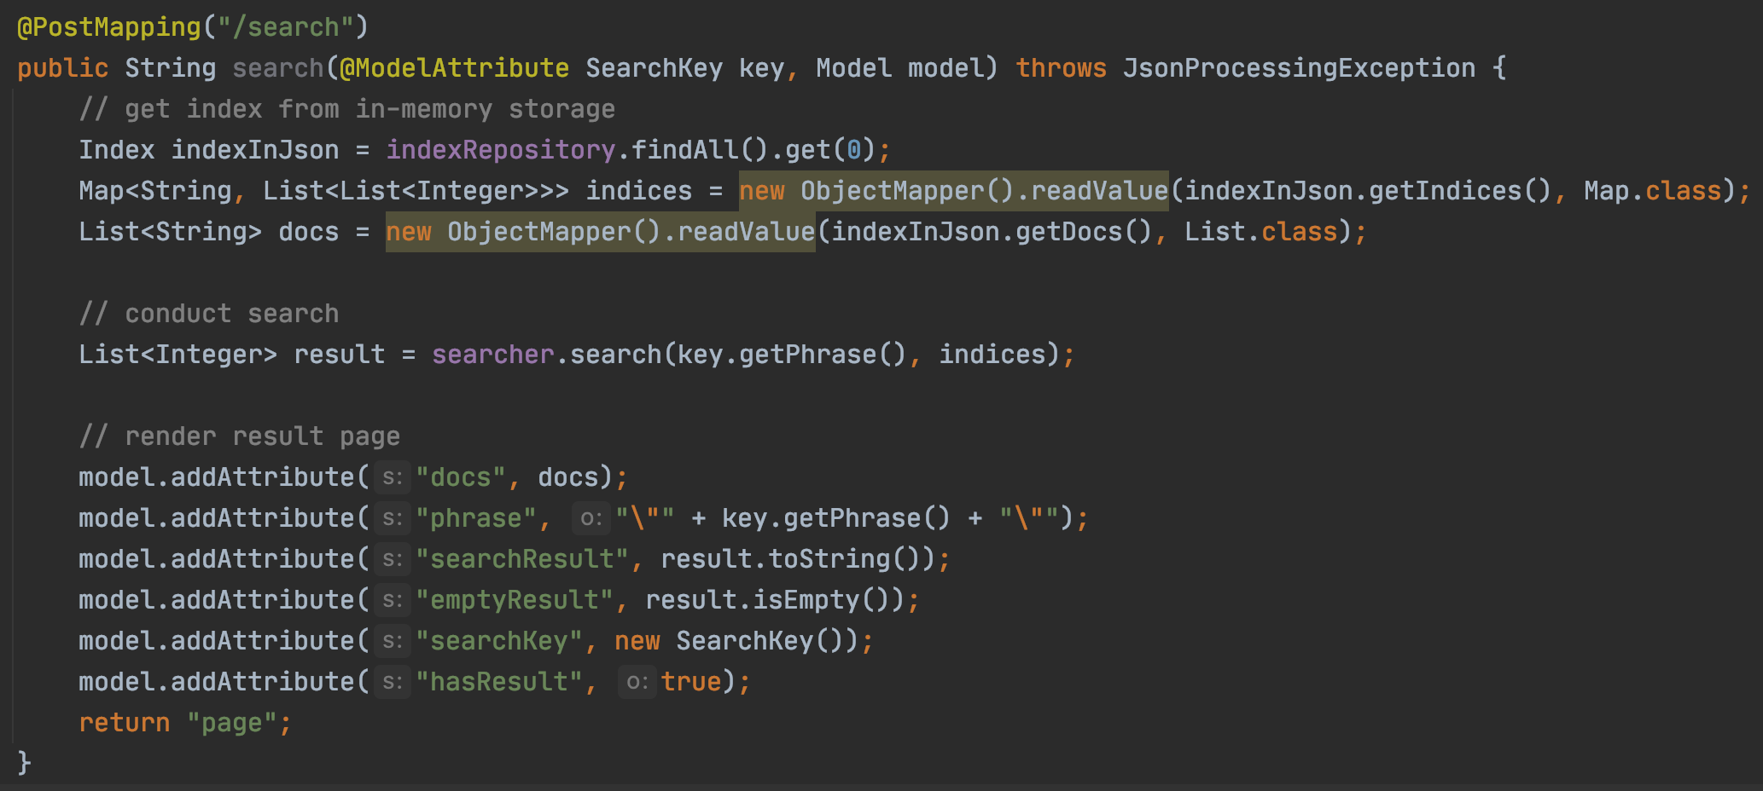
Final Project Review
https://github.com/pdgetrf/CSS143B-2020Fall-final-project/blob/60e3298186148f77b35fb975def7365d8eb9cef0/src/main/java/edu/uwb/css143b2020fall/controller/WebController.java#L78

Slide 28
Running vs Testing
Running
Unit Testing

Slide 29
Tasks
Doc 0 : "hello world", Doc 1 : "hello", Doc 2 : "world", Doc 3 : "world world hello", Doc 4 : "seattle rains hello abc world", Doc 5: "sunday hello world fun"
Search “hello world”

Slide 30
Tasks
Doc 0 : "hello world", Doc 1 : "hello", Doc 2 : "world", Doc 3 : "world world hello", Doc 4 : "seattle rains hello abc world", Doc 5: "sunday hello world fun"
Search “hello world”

Slide 31
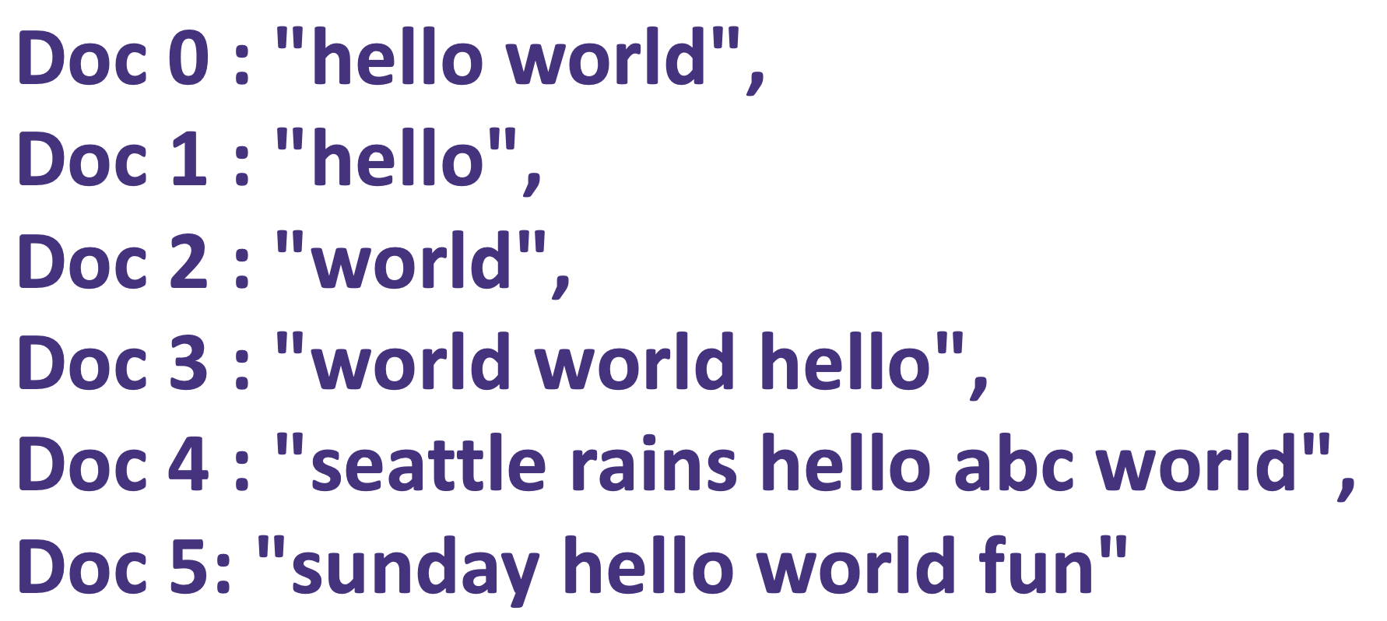
Design
Indexer
Searcher
Index
Search
Search

Slide 32
Index & Search Algorithm
Reading
http://www.ardendertat.com/2011/05/30/how-to-implement-a-search-engine-part-1-create-index

